Slide 1
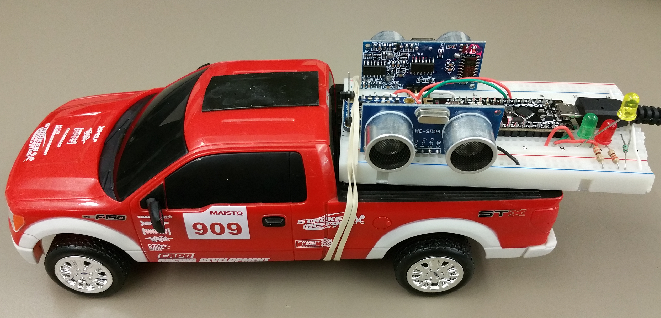
2-D Mapping Robot
By Camilo Moreno and Ahmed Awada

Slide 2
What does it do?
This project a remote controlled car robot that can create a rough* 2-D map of its surroundings through an Android app.
Using Bluetooth, the RC car will scan it’s surroundings and create the map from values obtained through the ultrasonic sensors.
rough* - very rough; see Final Report

Slide 3
Parts Used
Ultrasonic sensors
Bluno microcontroller
Breadboard
RC Car
USB battery pack

Slide 4
Design
The basic design of the project is having an RC car with a bread board mounted on the back and the battery on top of the car; the Bluetooth Bluno Microcontroller and the two Ultrasonic sensors are connected on the breadboard to each other and the battery.

Slide 5
How It Works
The general idea is that the while the RC car is being driven around, the two ultrasonic sensors are firing, hitting objects around it.
The sensors then pick up the echoes and relay the values to the Bluno, which then sends them to the Android app.
These values are collected, converted into points (x,y), and marked on an image.
The image created (roughly) reflects any obstacles that the sensors detected. An example can be found in the Final Report.

Slide 6
Challenges
We faced several challenges in this project:
We wanted to implement a 9DOF Adafruit accelerometer that would track the positioning of the car while it’s moving. Unfortunately we couldn’t get that to work right.
We initially had just one ultrasonic sensor on a servo motor that would rotate 180 degrees back and forth. We decided two sensors (one on each side of the car) would be more effective and quicker in “plotting” the environment.
The project was not fleshed out as much as hoped for; the current ‘single-direction’ plotting can be extended to multiple directions (and any direction in 2D, ideally) to more closely represent the tile given to the project, 2D Floor Mapping Car.

